Slide 1
Defining and Measuring Well-Being
Ed Diener

Slide 2
Complete the Scales Now. If You Have Not Finished, You Can Complete Them at Home (6 pages; stop when you get to Scoring Instructions)

Slide 3
History: What is Happiness? What is Well-Being?
Greek Philosophers
Hedonists, Epicureans
Utilitarians: Bentham
Aristotle (Eudaimonia)
Diener’s empirical approach
SWB
Eudaimonia

Slide 4
Types of Subjective Well-Being
Positive Affect
Negative Affect
Life Satisfaction
Satisfaction with Domains
(e.g., health, work, marriage)

Slide 5
Separation of SWB
Life satisfaction
With life and domains of life
Positive Feelings
Joy, enjoyment, love, awe, etc.
Low Negative Feelings
Anger, depression, anxiety, envy, guilt

Slide 6
Can We Measure SWB with Just One Number?
Not completely, no
Life satisfaction – material well-being
Positive affect – social well-being
Negative affect – personality, conflicts

Slide 7
The Summum Bonum?
Happiness is everything
The reason we seek all other goals
When we have it, we need nothing else

Slide 8
Is SWB the
Summum Bonum?

Slide 9
Methods to Assess Subjective Well-Being
Self-report surveys: How satisfied are you?
Family and friends
Smiling, laughing
Biological indicators
Cognitive measures (e.g., memory)
These CONVERGE!

Slide 10
Issue 1: Are SWB Measures Valid?
Self-reports
Experience
Sampling
Informant
Reports
Biological
Measures SWB
Objective
Behavior
Memory and RT
Interview

Slide 11
Are The Measures Valid?
Yes!
They correlate with each other
They predict future behavior
Not perfect, but pretty good
Grade: B

Slide 12
Discussion
Current mood influenced your score?
Global biases – some positive, some not?
Valid for you?

Slide 13
Eudaimonic Theories
Living a meaningful life; living in accord with human nature
Carol Ryff
Deci and Ryan
Martin Seligman -- PERMA

Slide 14
“Eudaimonic” Theories Self-Determination Theory
Ed Deci and Richard Ryan
Competence
Autonomy
Relatedness

Slide 15
Carol Ryff
Purpose
Mastery
Self-acceptance
Autonomy
Personal growth
Positive relationships

Slide 16
PERMA (Seligman)
Pleasure
Engagement (e.g., Flow)
Relationships
Meaning
Achievement

Slide 17
Empirical Relations Eudaimonic and Subjective Forms of Well-Being

Slide 18
Diener: Sustainable Happiness
The so-called Eudaimonic forms of well-being are important because they can create long-term subjective well-being
People cannot just seek pleasures to stay happy
People need long-term goals
Purpose and Meaning
People need others
People enjoy mastery and flow

Slide 19
Sustainable Happiness: Meaning

Slide 20
Useful Fiction
Although SWB and eudaimonia are not so separate as some would have us believe, it is useful to consider eudaimonia as valuable in itself because it can create long-term happiness for humans. These are things we need to be happy and to make others happy.

Slide 21
Discussion Important? Different?
Subjective well-being
Psychological well-being
Quality of life
Eudaimonia

Slide 22
Why Measure Well-Being?
To help people see where they are strong vs. need improvement
To guide policy
To use in scientific study
People attend to what is measured

Slide 23
Conclusions
There are several types of SWB
There are additional types of eudaimonic happiness
All these comprise psychological well-being
The self-report measures are reasonably valid
The measures have several useful purposes
Eudaimonia might be an approach to sustainable happiness

Slide 24
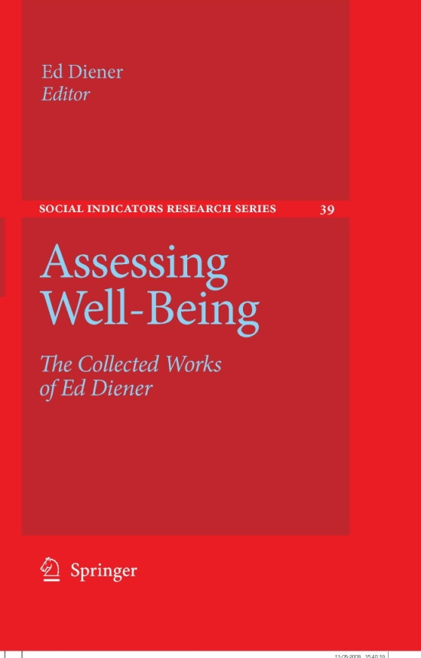

Slide 25
Diener’s scales measure the various forms of well-being
PA, NA, Life satisfaction
Mastery, achievement
Meaning and purpose]
Etc.

Slide 26
SCORING Reversing Negative Items
3 items on page 1
13, 14, 15
3 items on page 2
28, 29, 30
Subtract your answer from 6

Slide 27
Overview of Scale Scoring
Adding up subscales
Page 1,
Page 2,
Each section on Page 3, etc.
But first reversing six items

Slide 28
Scoring
Page 1 – add 18 items (after reversing)
Page 2 – add Add 21 items

Slide 29
Scale Norms
Page 1 – 18 items = Relationships Scale
Page 2 – 21 items = Mastery & Engagement
Page 3 – 3 items (40-42) Meaning/Purpose
Page 3 – 3 items (43-45) Optimism
Page 3 – 3 items (46-48) Life Satisfaction
Page 3 – 3 items (49-51) Positive Feelings
Page 3 – 3 items (52-54) Negative Feelings

Slide 30
Page 4
Flourishing Scale (8 items)
Add 55 – 63
Satisfaction with life scale (5 items)
Add 63 – 67
SPANE Positive Experience (6 items)
Add 68, 70, 72, 74, 77, 79
SPANE Negative Experience (6 items)
Add 69, 71, 73, 75, 76, 78

Slide 31
Thriving Scale Brief Psychological Well-Being Scale
(10 items)
Add items 3, 16, 20, 31, 34, 37, 40, 43, 48, and 51
Cantril’s Ladder – just whatever numbered step you are on is your score

Slide 32
Now you can move your scores to the Scales NORMS pages. Each score next to the appropriate scale, and you can circle the norm description that describes your score.

Slide 33
Your Profile of Well-Being
Relationships
Mastery/Engagement
Meaning/Purpose
SWB
Optimism
Life Satisfaction
Positive Experience
Negative Experience
Flourishing Scale
Brief Psychological Well-Being Scale (Thriving)
SWLS (Life satisfaction)
SPANE Positive experience
SPANE Negative experience
Cantril’s Scale (Ladder)

Slide 34
Discussion
How do you feel about the scales?
Reactions, responses?
Is your Eudaimonia different from your SWB?

