Slide 1
The Science of Well-Being -- Lecture and Exercises
Ed And Carol Diener
Workshop: June 18, 2013

Slide 2
A Short But Advanced Course on Subjective Well-Being (Moving beyond the simple findings)

Slide 3
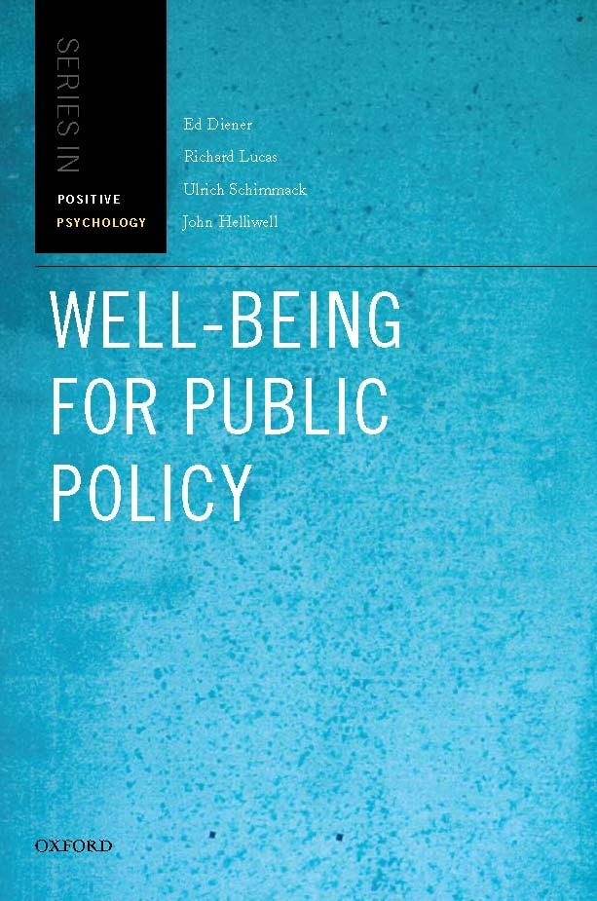
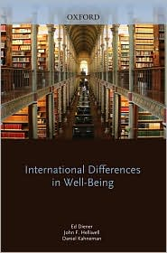

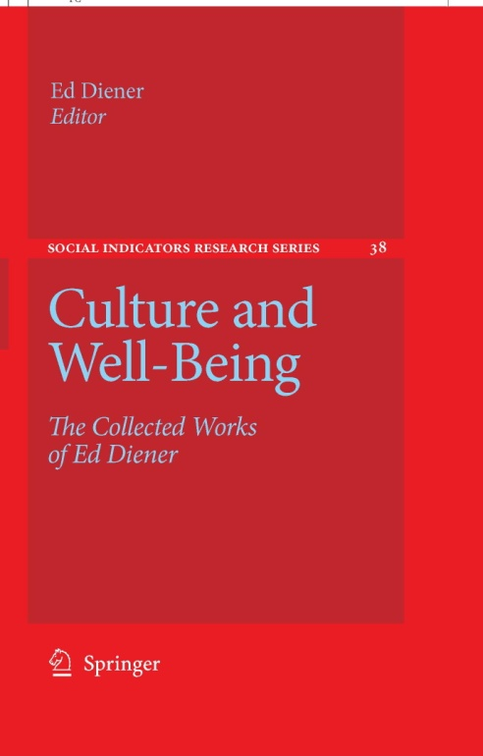
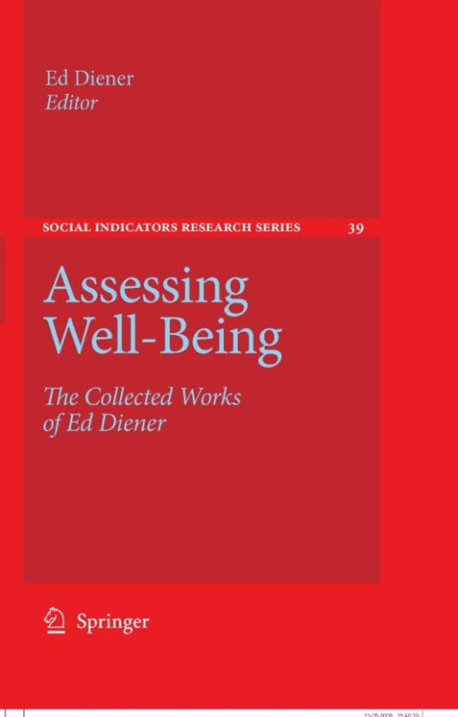
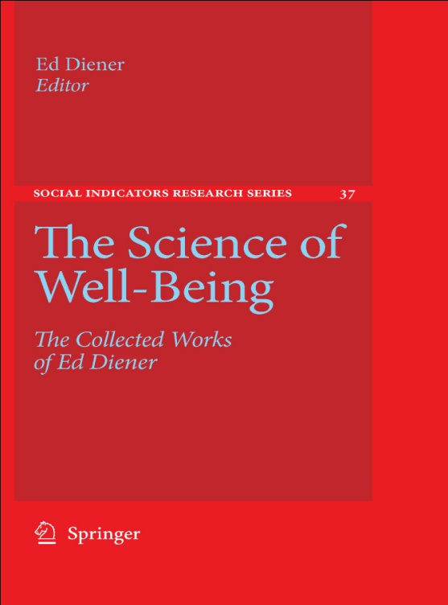
Notes:
3

Slide 4
Myths: Misbeliefs and Oversimplifications
Happiness is 50 percent genes and 50 percent under our control
SWB is primarily personal
Income is not important to happiness
People adapt to conditions, even paraplegia, and so in the long-run happiness is within the person
Marriage makes people happier
Religion makes people happy
Eudaimonia and SWB are clearly separable
Higher needs emerge after lower needs are met

Slide 5
But Useful Fictions
Although the myths are not literally true (for a scientist), they tend to capture some truth about SWB

Slide 6
Causes and Influences on Happiness External and Internal (Top-Down vs. Bottom-Up)

Slide 7
External
The society in which you live!
The spouse you marry.
The neighborhood in which you live.

Slide 8
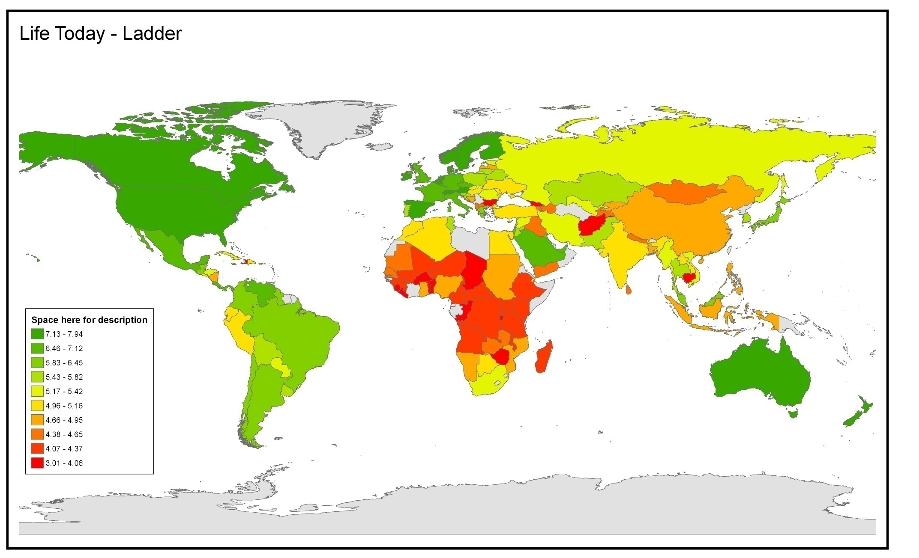
How is your life today? (Cantril ladder)
Mean Response (0 – 10)
Data Source: Gallup World Poll 2006-2008 waves

Slide 9
Is SWB Just Internal?

Slide 10
Internal Influence
Genes, inherited temperament

Slide 11
Temperament “Identical” (Monozygotic) Twins

Slide 12
Marissa & Mary Beth, Aged 4

Slide 13
Aged 38, Clinical Psychologist and Developmental Psychologist

Slide 14
Identical twins reared apart are more similar in subjective well-being than fraternal twins reared together!

Slide 15
50 %
Happines ½ under your control
Biggest myth
in SWB field

Slide 16
The Myth
50 percent? No, it varies by study – some show 30 %
50 percent? No, it varies by environmental variation. Heritability is not a fixed number
50 percent within? No, heritability is about differences between people, not within them
50 percent under your control? No, it says NOTHING about controllability!

Slide 17
Example
Hair color
Black, brown, red, blond
Purple, pink, grey, platinum blond, missing

Slide 18
Bottom Line
There are some genetic influences
Happiness is also to some degree under our control
The heritability percentages are not about how much we can control!

Slide 19
The Useful Fiction
Not 50 percent, but you can control some of your happiness, but perhaps not all of it. You choose how happy you are – a useful fiction?

Slide 20
Both Internal and External!
Personality Society
Outlook Neighborhood
Resilience Workplace
Positive Psychologists need to also focus on organizations and societies, not just what is within people!

Slide 21
So How Do we Get SWB?
Reduce negative feelings
Meditation
Resilience
Appraisal
Attachment
Seek more positive feelings

Slide 22
Seeking Positive Experience
The shortcut methods
Drugs, alcohol, sensation seeking
Quick sex
Purchasing luxury goods
Sustainable approaches
Deep relationships
Meaning and purpose
Developing and using skills

Slide 23
Internal Vs. External Influences -- Discussion and Questions

Slide 24
Money and Happiness?
Does money make us happy?
Yes or No?
Sorry, the answer is not so simple

Slide 25
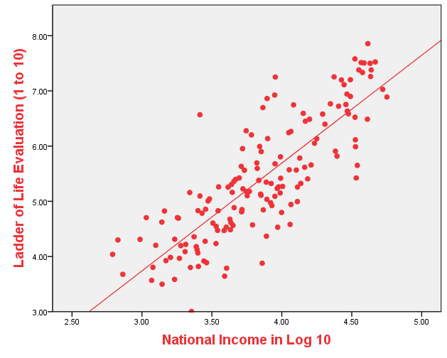
National Income and Life Evaluations r = .82 Diener, Kahneman, et al., 2010
Notes:
nn

Slide 26
Highest on Ladder
Ladder Income Rank (97)
Denmark 8.0 5
Finland 7.7 12
Switzerland 7.5 4
Netherlands 7.5 7
Canada 7.4 8
Norway 7.4 3
Sweden 7.4 13
Australia 7.4 11
New Zealand 7.3 22
Belgium 7.3 9
United States 7.2 1
Israel 7.2 20
Spain 7.2 19
Ireland 7.1 2

Slide 27
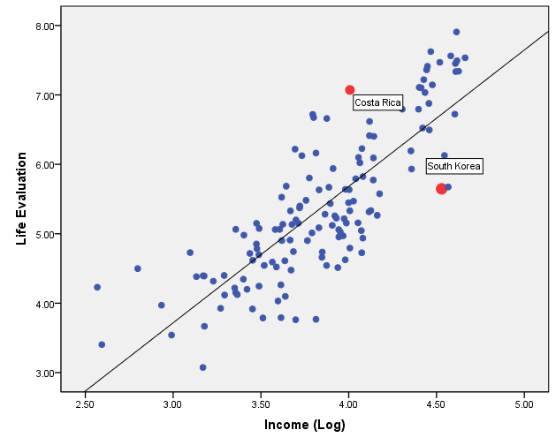
Beyond Money: A Tale of Two Nations

Slide 28
Subjective Well-Being
South Costa
Korea Rica
Life Satisfaction 5.65 7.25
Positive Feelings .88 .67
Negative Feelings .22 .20
GDP/Person $ 46,500 12,800

Slide 29
In General
High income nations higher in life satisfaction
Also higher in stress

Slide 30
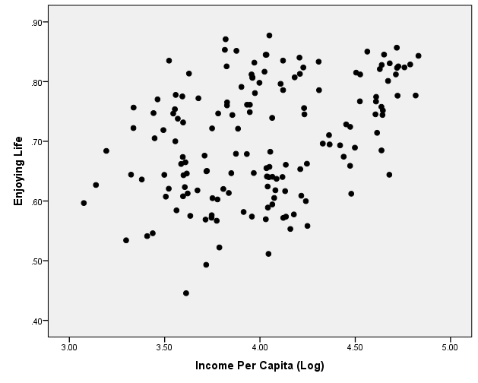
Income and Enjoying Life

Slide 32
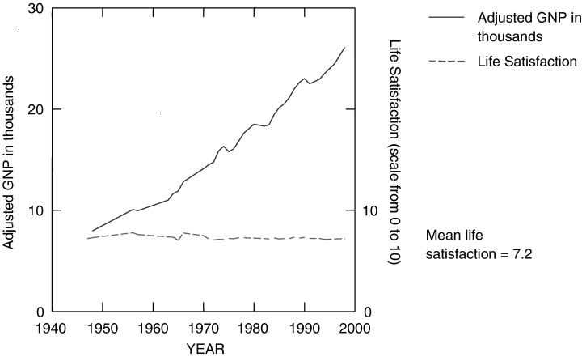

Slide 33
Materialism Can Be Bad
Valuing money more than other things can lower SWB

Slide 34
Materialism When Entering College, & Income and Life Satisfaction at Age 38 (Nickerson, Kahneman, Diener, & Schwarz, Psych. Science, 2003)

Slide 35
Money and happiness:
Depends on aspirations
Depends on how money spent (Liz Dunn)
Luxury goods vs. helping others
Depends on what is expected in the future
Depends on personal AND societal income
Depends on meeting basic needs vs. luxury—declining marginal utility
Other factors can override income (e.g.,
S. Korea)
Depends on what type of SWB (life satisfaction vs. enjoying life

Slide 36
The Useful Fiction
Money won’t make you happy = don’t sacrifice too many other things just to get rich. You need an enjoyable job and good social relationships too.

Slide 37
Money and Happiness -- Questions and Discussion

Slide 38
Declining Marginal Utility
Income
BUT – other resources also show DMU
Friends
Leisure time
So BALANCE in life. But also activities – meaning, skills and flow, and relationships

Slide 39
Benefits of High SWB
High SWB CAUSES (Does not just follow from):
Better health
On average more longevity
Better social relationships
High income and work performance

Slide 40
Health & Longevity The Nun Study
Dr. Snowdon with Sisters Agnes and Gertrude

Slide 41
Longevity: The Nun Study Danner, Snowden, & Friesen, U Kentucky
1. PA in autobiographies at age 22
2. Happy and less happy nuns living in same life circumstances through lifespa
How long do they live?

Slide 42
Longevity in The Nun Study
Survival Rate at Age: 85 93
Most Cheerful Quartile 79% 52%
Least Cheerful 54% 18%

Slide 43
My Doc Asks:
Smoking
Exercise
Seat belts
Weight
Drinking alcohol

Slide 44
Smoking (pack/day)
Exercise
Seat belts
Weight
Heavy drinking
Hey, Doc, what about:

Slide 45
Smoking (pack/day)
Exercise
Seat belts
Weight
Heavy drinking
Hey, Doc, what about:
Have you thought of becoming a nun?

Slide 46
Smoking (pack/day)
Exercise
Seat belts
Weight
Heavy drinking
Hey, Doc, what about:
How happy are you?
Very Happy vs. Less Happy + 10.7 years

Slide 47
44 Prospective Studies Controlling Time 1 Health, Income etc.
Longevity Health/Disease
Positive findings 25 15
Null findings 0 2
Reverse findings 1 1

Slide 48
SWB Benefits Social Relationships

Slide 49
College Entry Cheerfulness, and Income 19 years later Diener, Nickerson, Lucas, & Sandvik (2002)

Slide 50
Individual Life Satisfaction Predicts Future Events Replicated findings from nationally representative samples of Germany, Australia, & U.K.
Job loss
Divorce
Parenthood
Relocation
Starting a new job

Slide 51
The Benefits of High SWB --Questions and Discussion

Slide 53
Culture
Cutural Relativism vs. “Sick” cultures (Robert Edgerton)
All cultures are equally happy?

Slide 54
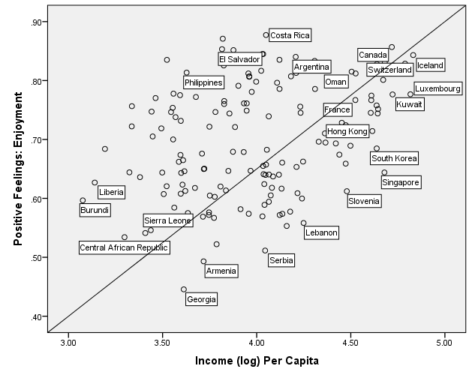
Culture and Enjoying Life -- Confucian Vs. Latin Cultures

Slide 55
Groups we have studied
Yagua
Maasai
Inuit
Amish
Homeless
Sex workers
Calcutta slum dwellers

Slide 56
Life Satisfaction Means (1-7)
US Multimillionaires (Forbes list) 5.8
Amish (Pennsylvania) 5.8
African Masai 5.4
Greenland Inuit 5.0
Amish (Illinois) 4.4
NEUTRAL = 4.0
Calcutta Sex Workers 3.6
Calcutta Homeless 3.2
California Homeless 2.9
Mental Inpatients 2.4
Detroit Sex Workers 2.1

Slide 57
Universal Predictors
Around the globe
Social support and respect
Basic physical needs
Using skills at work
Trust and safety

Slide 58
Maslow?
We find that the needs are universal
Basic needs
Social support, respect, trust
Using skills
BUT no hierarchy: All the needs are there all the time, and contribute to SWB

Slide 60
Human Evolution
Food
Safety
Friends and family
Skills and mastery

Slide 61
Culturally Different Predictors
Example
Self-esteem – much more central to life satisfaction in individualistic cultures
Emotions more central to life satisfaction in individualistic cultures
Approval of others a bit less important to individualists than to collectivists

Slide 62
Also: Cultural Congruence (Fulmer, Gelfand, … Diener et al., Psych Science)
Example: Extraverts are happier in an extraverted society

Slide 63
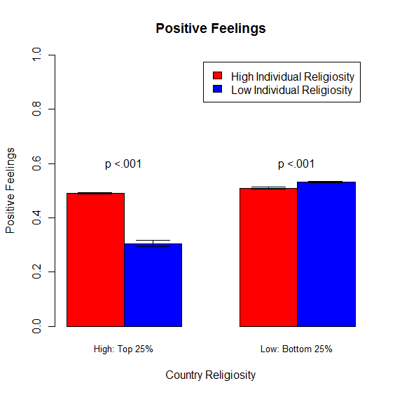
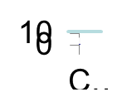
Cultural Congruence: Religion Diener, Tay, & Myers, 2011 JPSP

Slide 64
Useful Fiction
We might not all need religion to be happy. But we need some of the things it can provide:
Meaning and purpose
Social support
Optimism
A sense of control

Slide 65
Culture
Questions and Discussion

Slide 66
Psychological Adaptation
People react to good and bad events, but then over time this response fades
Brickman, Coates, & Janoff-Bulman

Slide 67
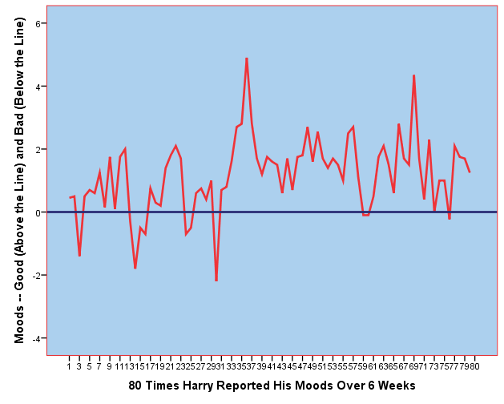

Slide 68
Adaptation to Marriage Lucas, Clark, Georgellis, & Diener

Slide 69
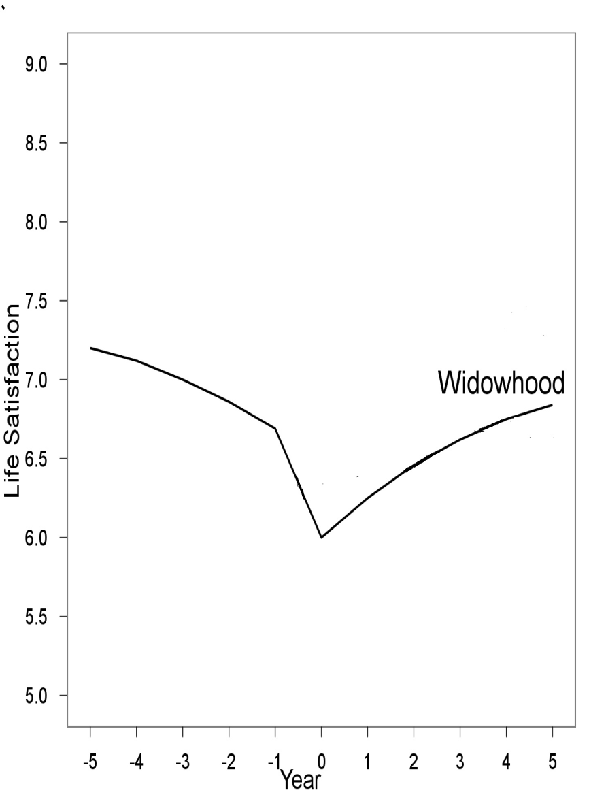
Happier Without a Spouse? Should I Kill My Husband?

Slide 70
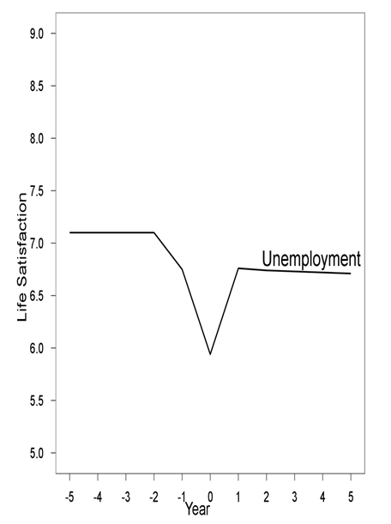
Plus, You Will Become Unemployed

Slide 71
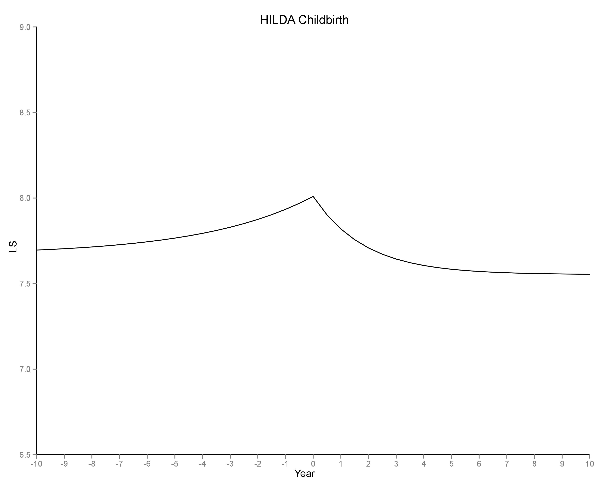
Will You Be Happier with Kids? -- Average person: No

Slide 72
Who Stays Married and Who Gets Divorced?

Slide 73
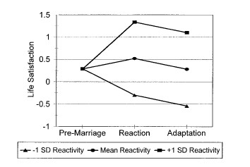
Marriage

Slide 74
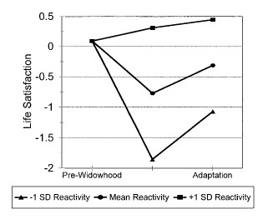
Widowhood

Slide 75
LESSONS
Married and those with kids happier. But causality? They were happier to start with – selection. Be careful of findings based on correlations.
There are huge individual differences. Marriage and kids will make some happier, and some less happy. Marrying whom? Your personality? Do you really love kids? Etc.

Slide 76
The Useful Fiction
We do adapt to a lot of things, so don’t put all our bets on them. A new car, a new house, a new job.
Example: Ed award, Ed research

Slide 77
Adaptation Discussion
Speeding adaptation to bad events
Reducing adaptation to good events

Slide 78
Social Comparison
People who compare a lot are less happy
Neurotics compare a lot
For income a world standard is emerging
Richest nations set the standard (T.V.)
A poor nation can get richer and become more happy if it falls below richer nations, or aspirations rise too fast.

Slide 79
National Accounts of SWB
Diener and Seligman (2004)
-- Nations need to monitor psychological well-being, not
just GDP and other economic indicators

Slide 80
Robert Kennedy, 1968
Too much and for too long, we seemed to have surrendered personal excellence and community values in the mere accumulation of material things. Our Gross Nation Product . . . counts .. cigarette advertising, and ambulances to clear our highways of carnage…. Yet the gross national product does not allow for the . . . quality of our marriages, the intelligence of our public debate or the integrity of our public officials. It measures neither our wit nor our courage, neither our wisdom nor our learning, neither our compassion nor our devotion to our country, it measures everything in short, except that which makes life worthwhile.

Slide 81
Why Accounts of SWB?
Money and other indicators do not capture everything about quality of life
People value happiness
SWB reflects broad aspects of quality of life
High SWB brings about other benefits
SWB can shed light on policy debates

Slide 82
People Highly Value Happiness
Student in 47 nations
Domain Importance (1 – 9)
Happiness 8.0
Love 7.9
Health 7.9
Wealth 6.8
Getting to heaven 6.7

Slide 83
SWB relevant to policy issues:
Example: Prostitution
Example: Green space
Example: Commuting to work
Example: Progressive income tax
Example: Clean air
Example: Allocation health research money

Slide 84
National Accounts of SWB
UK, Mexico, Japan, Chile etc.
OECD (Organization of Economic Cooperation and Development) guidelines!

Slide 85
National Accounts of SWB
Discussion and Questions

Slide 86
Demographics and SWB
Income
Religion
Gender
Age

Slide 87
Ed Diener’s Web Site
http://www.psych.uiuc.edu/~ediener/

Slide 88
Conclusions
SWB is a valuable thing! Good for the individual; good for societies
We need good societies too
Societies need to monitor SWB
Individuals need to strive for sustainable happiness
Money matters, but is not overriding
We can foster happiness with positive attitudes and behavior

Slide 89
The Easterlin Paradox
Richard Easterlin (1974) – as nations grow richer they do not grow happier.
BUT: Hagerty and Veenhoven, & Stephenson and Wolfers find they do get happier. Ongoing debate.

Slide 90
Diener, E., Tay, L., & Oishi, S. (2013). Rising income and the subjective well-being of nations. Journal of Personality & Social Psychology, 104, 267-276.
On average nations go up, but only about 56% of them, not all. So LOTS of exceptions.
Depends on:
Aspirations not rising faster
Actual increases in quality of life
Optimism about the future

Slide 91
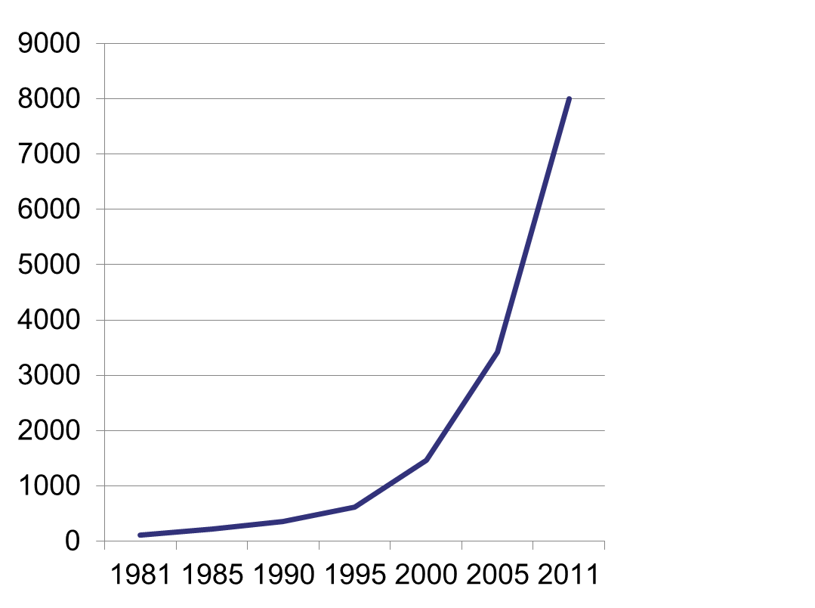

Slide 92
Thank you so much!
It was a great day!
It was fun!

