Slide 1
Ethical TRAPS in Psychotherapy
Elaine Shpungin, Ph.D.
Director of Conflict 180
(former Director of UIUC Psychological Services Center)

Slide 2
Ethics in Psychotherapy
Moral Codes (e.g., religious, philosophical)
Example: abortion
Ethical Codes (American Psychological Association)
Example: interrogation techniques
Legal Codes (state and federal)
Example: child abuse or neglect

Slide 3
APA General Principles
Principle A: Beneficence and Nonmaleficence
Principle B: Fidelity and Responsibility
Principle C: Integrity
Principle D: Justice
Principle E: Respect for People's Rights and Dignity

Slide 4
Examples of Specific Principles
Informed Consent (High risk treatments)
Privacy and Confidentiality (Laptop; Limits)
Boundaries of Competence (False memories)
Sexual Intimacy and Dual Relationships
Record Keeping and Documentation (Suicide by razor)

Slide 5
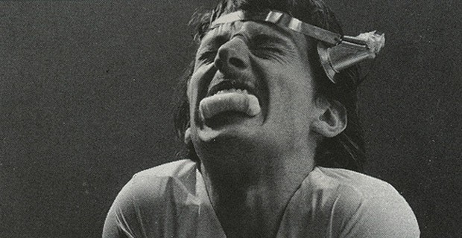
1. Informed Consent: Shock Therapy Lawsuits 1950s
High risk of death & injury
Benefits for some cases of severe depression and anxiety
False assurances made lawsuits successful
Photo: Sleuth Journal 2013

Slide 6
What Would You Do?
Trauma Focused CBT for kids involves telling the traumatic story many times
Jeana is 12 and has nightmares after a car accident
Jeana’s mom is Consenting to TFCBT on her behalf because Jeana is a minor
Has “informed consent happened?”
What would you advise Jeana’s therapist?

Slide 7
2a. Confidentiality (Adults): The Stolen Laptop
October 14, 2013
Prostitute takes laptop, psychologist loses license
The state has suspended the license of a Gig Harbor psychologist (Sunil Kakar, 46) after a prostitute allegedly took his laptop containing personal information of 652 clients.

Slide 8
What Would You Do?
Keith is a therapist at Carle
Keith needs to finish a report before his session with a client tomorrow morning
Keith wants to take a copy of DE-IDENTIFIED report home on his jump-drive to finish
What would you advise Keith?

Slide 9
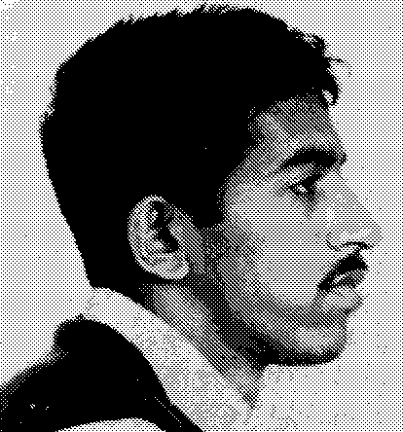
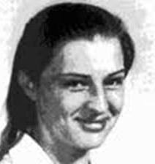
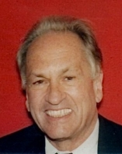
2b. Limits to Confidentiality Tarasoff vs. U of California 1976
Poddar Told therapist he wanted to kill Tarasoff
Therapist informed police AND tried to hospitalize Poddar
Murdered Tarasoff after stalking
Family sued therapist & university
Prosenjit Poddar
1969
Tatiana Tarasoff
1969
Dr. Lawrence Moore
2013
Prosenjit Podar
Today

Slide 10
MAKING THE DECISION: To Warn or Not To Warn?
How SERIOUS or LETHAL is the threat?
How LIKELY is the threat?
How FEASIBLE is the threat? (means?)
How IMMINENT is the threat?
2013: Dr. Bersoff (then President of APA):
Tarassoff laws leave too much ambiguity and judgment on therapist

Slide 11
What Would You Do?
(Serious? Likely? Feasible? Imminent?)
Client at PSC says he will cut off his ex-girlfriend’s new boyfriend’s private parts
Client knows where new boyfriend lives in Chicago
Client has physical condition that prevents him from driving
Client has phobia of public transportation
Client has full-time caregiver during the day

Slide 12
3. Competence: False Memory Lawsuits 1990s
“The Search for Satan” Frontline (1997)
What made lawsuit successful?
Patricia Burges: Accusation of “False memories”; Settled for more than $10 M

Slide 13
What Would You Do?
Dr. Malone is asked to supervise a student on a case when another therapist drops it
Dr. Malone will not have access to audio or video and has limited expertise in this area
If Malone does not take the case, the children on caseload will get NO CARE for many months
What would you advise Dr. Malone?

Slide 14
4. Sexual Intimacy & Dual Relations Famous Psycholgist Loses License 2013
2013: The board concluded that he violated five regulations, including “engaging in verbal or physical behavior toward a client that is sexually seductive, demeaning or harassing,” having sexual intercourse with a client and endangering the client’s welfare “with sexual or other dual relations.”

Slide 15
What Would You Do?
Dr. Kristoff finds out after two months of dating Jacki that she is the SISTER of a current client
Dr. Kristoff and Jacki believe they are in love and may want to get married
Dr. Kristoff also wants to be ethical
What would you advise Dr. Kristoff?

Slide 16
5. Documentation: The Razor 1980
Army Psychiatrist Found Liable in Suicide Case
Dr. Hipolito, army psychiatrist, lost patient - Mr. Abille - to suicide
Dr. Hipolito changed Mr. Abille’s status to high risk ORALLY
Without documentation, Mr. Abille received permission from nurse to shave
Mr. Abille killed himself with the razor

Slide 17
What Would You Do?
You are seeing a couple for marital therapy
You always see them together
One of the spouses calls you on the phone and tells you she is cheating on her spouse
She begs you not to put the information in your notes because both spouses have access to the notes
What would you do?

Slide 18
Thank You!
elaine@conflict180.com

