Slide 1
Meditation and Mindfulness: Applications and Benefits in Psychotherapy Treatment John T. Jones, Ph.D.

Slide 2
Notes:
Feb. 3, 2014
If you had any question as to the surge in popularity and interest in meditation, and mindfulness in particular, I wanted to share a few recent examples…

Slide 3
Notes:
November, 2014 – Richard Davidson, Mathieu Ricard, Antoine Lutz

Slide 4
Notes:
Feb. 18, 2015 – TIME
Mini Meditators – Mindfulness and mediation exercises are helping kids get an edge in the classroom….
MORE KINDNESS – MORE SELF-CONTROL - BETTER MATH SCORES – LESS DEPRESSION – FEWER SYMPOTOMS – IMPROVED FOCUS

Slide 5
Notes:
Scientific American Mind
Article on Mindfulness in elementary schools

Slide 6
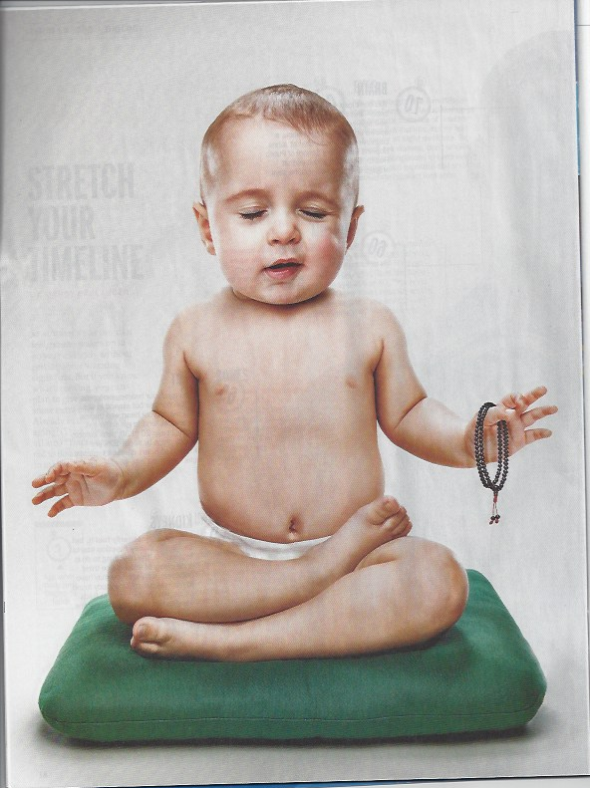
Notes:
TIME – Double Issue, FEB 23rd & March 2nd - Special Health Issue – LIVING LONGER
QUOTING RICHIE DAVIDSON – “The Regular Practice of Meditation Seems to be able to alter the trajectory of age-related changes”

Slide 7
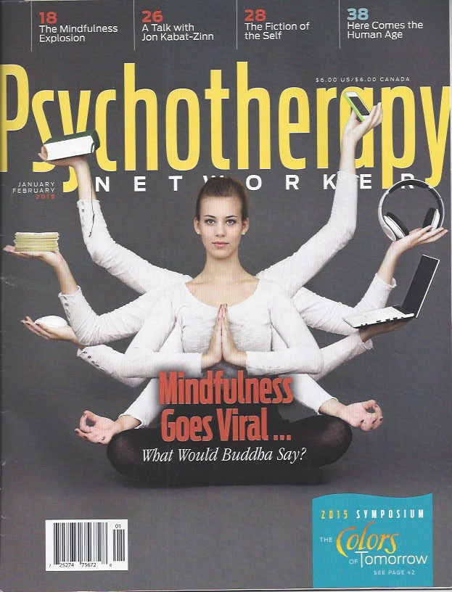
Notes:
January/February 2015
Mindfulness Goes Viral

Slide 8
Notes:
THIS SURGE IN INTEREST DID NOT OCCUR Overnight
American Journal of Psychiatry – 1977 –
READ FROM THE KUTZ, BORYSENKO and BENSON

Slide 9
Notes:
Kutz, Borysenko & Benson – 1985
VERY INFLUENTIAL PAPER FOR A LOT OF People INTERESTED IN MEDITATION
I JUST WANT TO READ FROM THE FIRST FEW PARAGRAPHS OF THIS PAPER….READ FIRST PAGE
Meditation practices have been with us for thousands of years – AND, as we’ll discuss, they’ve been studied in psychology and psychiatry for several decades
Sooooo….WHY NOW – WHY THIS SURGE IN POPULARITY and PROMINENCE NOW – I want you to sit with that question, and we’ll return to it later

Slide 10
Training the Mind
The faculty of voluntarily bringing back a wandering attention, over and over again, is the very root of judgment, character, and will. No one is compos sui if he have it not. An education which should improve this faculty would be the education par excellence. But it is easier to define this ideal than to give practical instructions for bringing it about. (William James, 1890)
Notes:
HMMMM – What might the practtcal instructions be –

Slide 11
Notes:
OBSERVING RESPIRATION

Slide 12
Brief History of Research & Theoretical Developments
Herbert Benson - (TM) - The Relaxation Response (1975)
Jon Kabat-Zinn – (MBSR) Full Catastrophe Living (1990)
Dialectical Behavior Therapy – (DBT) Marsha Linehan – Book and treatment manual – (1993)
Acceptance and Commitment Therapy – (ACT) Steven Hayes – First Edition Published (1999)
Notes:
Herbert Besnon – TM – Transcendental Meditation - Maharishi Mahesh Yogi – Fairfield, Iowa – well over 600 studies on TM alone – concentration form

Slide 13
Brief History of Research & Theoretical Developments
Mindfulness Based Cognitive Therapy – (MBCT) - Segel, Williams, Teasdale – The Mindful Way Through Depression: Freeing Yourself From Chronic Unhappiness (2007)
Mindfulness Based Relapse Prevention (MBRP) (Bowen, Chawla and Marlatt, 2010) is a novel treatment approach developed at the Addictive Behaviors Research Center at the University of Washington, for individuals in recovery from addictive behaviors.
Notes:
MANY OTHERS –
INCLUDING Mark Epstein – Psychiatrist – psychoanalytically inclined psychotherapist - Thoughts Without a Thinker (1995)– Going to Pieces without falling apart (1998) – Open to Desire (2005) - Psychotherapy without the self (2008) – His latest – The Trauma of Everyday Life (2013)

Slide 14
What Is Meditation?
Three Broad Categories:
- Concentration Forms
- Opening-Up (Mindfulness) Forms
- Compassion
Notes:
Meditation is found in virtually all cultures around the planet – Christian contemplative prayer, Islam – Sufi tradition – Jewish – Kabbalah – Hinduism, Taoism – most clearly described in Buddhism
Meditation did not begin with the Buddha – nor is it exclusive to Buddhism – WHICH ITSELF HAS ITS Roots in Hinduism – BUT Buddhist tradition is one of the most clearly mapped out meditative traditions
My Own Meditative Tradition is rooted in Hindu Yoga…..
MEDITATION CAN BE DEFINED AS - INTENTIONAL REGULATION OF ATTENTION FROM MOMENT TO MOMENT – (BENSON, ET AL) - THIS FITS ALL FORMS OF MEDITATION
THESE BROAD CATEGORIES OR FORMS ARE NOT MUTUALLY EXCLUSIVE – OFTEN PRACTIICED TOGETHER – OR USED SELECTIVELY DEPENDING ON THE CASE

Slide 15
Concentration Forms
Focused Attention
Calm Abiding
Shamatha
Samadhi
Notes:
stabilize the mind – calms the mind
ATTENTION REGULATION
Object of meditation could be the breath, a mantra (word or phrase), an image
USUALLY THE BEGINNING PLACE FOR ALL MEDITATION PRACTICE
If observing respiration is too unsettling – anxiety provoking – then can focus on parts of the body further from the core, or on sound, or on a word (mantra) or image
In time – the outcome is that meditator, object of meditation, and act of meditating become one – blissful state of union
CAN BE CALMING IN CASES OF TRAUMA

Slide 16
Opening-Up Forms
Open-Monitoring
Insight
Special Insight
Vipasyana (Vipassana)
Mindfulness
Notes:
Opening-up – AKA – open-monitoring - vipassana – insight – special insight –
Attention/awareness on whatever arises
Cultivation of the Observer Self - IN ACT – SELF AS CONTEXT
EMOTION REGULATION – NON-REACTIVE AWARENESS
Facilitates greater self-acceptance and acceptance of what is
In time - insight into the nature of Mind – I am not my thoughts, my feelings, my narrative – though I have thoughts, feelings, narrative

Slide 17
Compassion Meditation
Meta Practice
Loving-Kindness
Tonglen
Notes:
GROWING IN COMPASSION – DISTINGUISH BETWEEN COMPASSION AND IDIOT COMPASSION – TRUNGPA
Cultivating self-compassion and compassion for others
Reduces empathy fatigue or compassion fatigue
In CASES OF TRAUMA - Can be settling/calming

Slide 18
Mindfulness – A Definition
The awareness that emerges through paying attention on purpose, in the present moment, and nonjudgmentally to the unfolding of experience moment by moment. (Jon Kabat-Zinn)

Slide 19
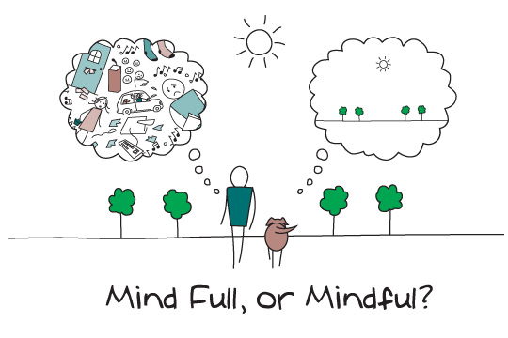
Notes:
One thing at a time
But in attending to the mind – there will be times that it is like the picture on the left, even after many years of practice

Slide 20
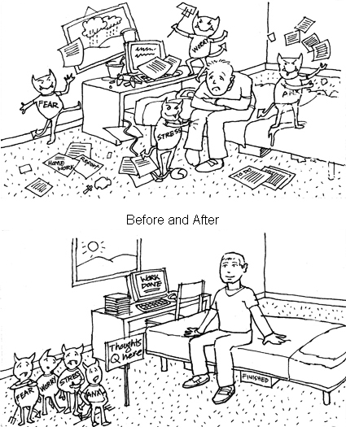
Mindfulness Is Far More Than Tidying Up Your Mind
Notes:
Not going to get it all tidy
Really about embracing and accepting the messiness of life

Slide 21
Mindfulness
Mindfulness in its most general sense is about waking up from a life on automatic, and being sensitive to novelty in our everyday experiences. With mindful awareness the flow of energy and information that is our mind enters our conscious attention and we can both appreciate its contents and also come to regulate its flow in a new way. Mindful awareness…actually involves more than just simply being aware: It involves being aware of aspects of the mind itself. Instead of being on automatic and mindless, mindfulness helps us awaken, and by reflecting on the mind we are enabled to make choices and thus change becomes possible. (Daniel Siegel)
Notes:
What is MIND – IS IT THE BRAIN?
Siegel defines mind as a process – the FLOW OF ENERGY AND INFORMATION
QUOTE FROM THE MINDFUL BRAIN
Julio – Power of Habit (2012) – Charles Duhigg
BEGINNER’S MIND – SUZUKI
Mind is not in the head – it is throughout and beyond the boundaries of the body – example of DRIVING A CAR – TAI JI

Slide 22
Selected Benefits of Mindfulness Practice
Relieving Anxiety
Relieving Depression
Relieving Pain
Increased Awareness
Emotion Regulation
Evokes Relaxation Response
Notes:
These Benefits are strongly Supported
Neuroimaging is showing Changes in Brain Function and Structure –
Increased Cortical Thickness
Increase in Gray Matter Volume
Decrease in Age-Related Cortical Atrophy – Slowing Normal Aging

Slide 23
Why Now?
Notes:
WHY NOW – WHY THE SURGE – Kabat Zinn secularized the practices, but so had Benson – no longer relying on self-report? but in fact that was the case with Benson’s research, as well – discovery of neuroplasticity – the MIND CAN CHANGE THE BRAIN – Benson and others are now looking at epigentics – RICHIE Davidson and others looking at neuroimaging – how the function and structure of the brain changes with meditation practice –
Dalai Lama – interested in science – has allowed advanced meditators to become research subjects
READ FROM SECOND PAGE OF KUTZ, BORYSENKO AND BENSON….FINALLY – 30 years after the publication of that paper….

Slide 24
I should also say one of the roots of the word “meditation” in Sanskrit comes from the word “familiarization.” And according to that definition, meditation is actually familiarizing yourself with your own mind. I would go so far as to say that I believe that for anyone who is a student of the mind, a student of psychology, doing meditation would be very useful, because it is a practice in which they can become more familiar with their own mind, and I think that it can help them become better psychologists.
(Richard J. Davidson)
Notes:
From APA Monitor Interview – Sept. 2012
COAL- Dan Siegel
IF TIME - PRACTICE - Meta – Loving Kindness – Compassion Practice

