Slide 1
Mindfulness in Psychology

Slide 2
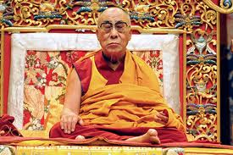
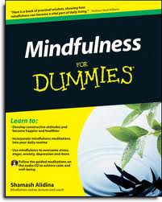
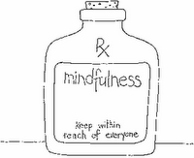
Why is Mindfulness important?

Slide 3
Outline
Mindfulness definition
A mindfulness exercise
Origins of mindfulness in psychology
A brief overview of mindfulness practices
The raisin exercise
Closing

Slide 4
What is mindfulness?
Mindfulness is a non-judgmental awareness of the present moment
Mindfulness is not just meditation, but can be a way of experiencing emotions, experiences, eating, and all of life.

Slide 5
Effects of Mindfulness
Mindfulness has beneficial effects on both psychological and psychosomatic problems such as anxiety, addiction, aggression, suicidality, depression, chronic pain, insomnia, and hypertension
Found to reduce, negative personality traits, reducing stress, and improve attention
Mindfulness has even been shown to decrease treatment time for psoriasis

Slide 6
Mindfulness practice

Slide 7
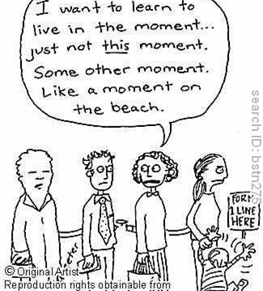

Slide 8
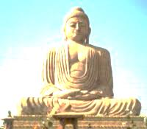
History Of Mindfulness
Mindfulness (sati) was originally taken from Buddhism
Many of the famous mindfulness psychologists studied Buddhism and brought components of Buddhist practice into psychology
While Eastern meditative practices have been integrated into psychology before (in various ways ex/ transcendental meditation in the 1950s), mindfulness is now predominately considered under the umbrella of Cognitive-Behavioral therapies
Now there are many different types of mindfulness therapies
including MBSR, MBCT, and DBT

Slide 9
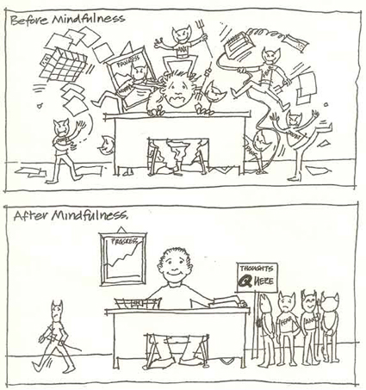
Mindfulness-Based Stress Reduction (MBSR)
Created by Jon Kabat-Zinn (who studied Zen Buddhism)
Closely resembles Buddhist mindfulness practice
A manualized 8 week program with one full-day practice and daily guided meditation
Stems from the idea that our distress/suffering comes from continually wanting things to be different than they are
Jon Kabat-Zinn on MBSR

Slide 10
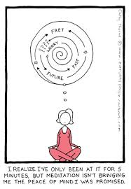
Mindfulness-Based Cognitive Therapy (MBCT)
Developed by Zindel Segal, Mark Williams and John Teasdale
Adapted from MBSR, this is a structured 8-week group treatment for depression which merges the ideas of MBSR and CBT
Participants are taught ways to respond to their automatic negative thought patterns
Zindel Segal on MBCT

Slide 11
Dialectical Behavioral Therapy(DBT)
Created by Marsha Linehan originally for suicidal individuals
Combines aspects of CBT and mindfulness
CBT techniques include skills training, homework assignments, symptom rating scales, and behavioral analysis
Mindfulness skills such as wise mind, and radical acceptance
“Dialetics” is a complex concept that has its roots in philosophy and science….[It] involves several assumptions about the nature of reality: 1) everything is connected to everything else; 2) change is constant and inevitable; and 3) opposites can be integrated to form a closer approximating to the truth (which is always evolving).
Is now used with many different type of clients (including those with Borderline PD, severe depression and binge-eating disorder)
Marsha Linehan on DBT- Part 1
Marsha Linehan on DBT- Part 2

Slide 12
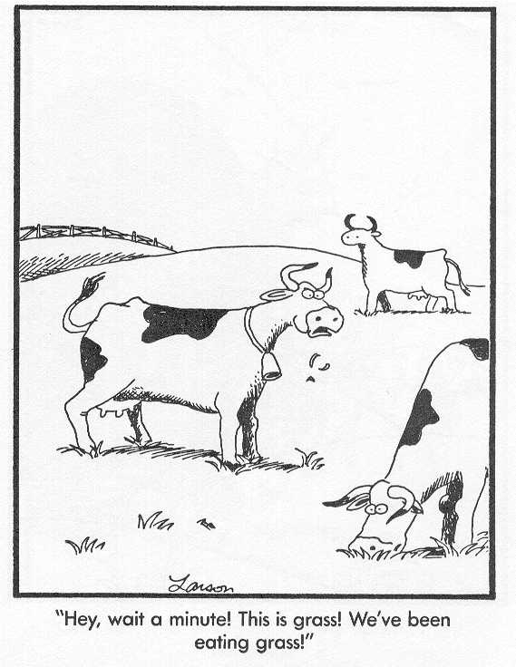
Raisin Exercise
raisin exercise
Experiences
Why did we spend so much time eating a raisin?
To:
cultivate awareness
begin to learn to focus on the here-and-now
be in the present moment and not miss out on it
Use beginner’s mind (to not take experiences for granted)

Slide 13
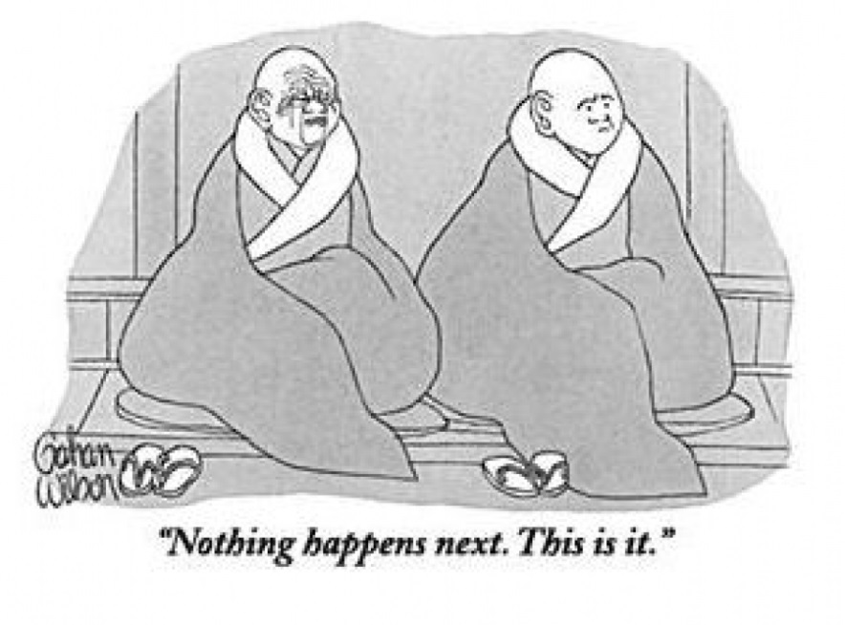
Concluding thoughts
Take-homes
Feedback

